Slide 1
Project 2: Classification
CUNY LaGuardia Community College

Slide 2
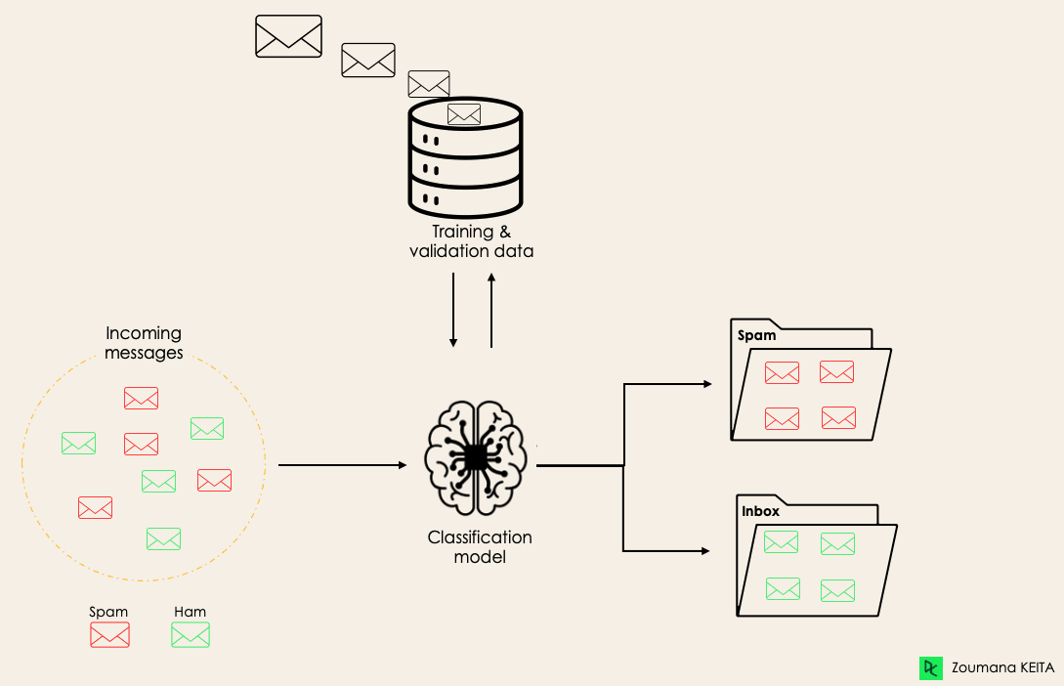
Classification Models

Slide 3
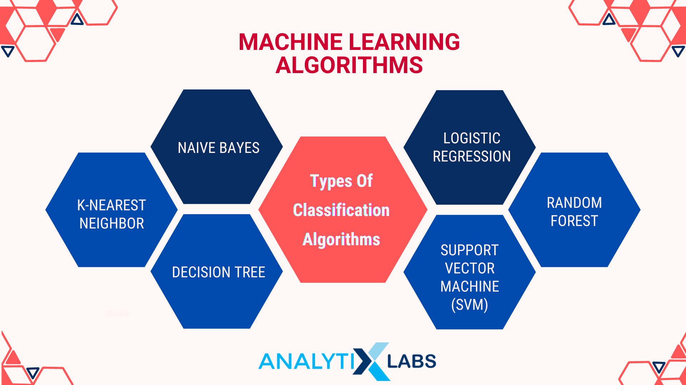
Types of Classification Models

Slide 4
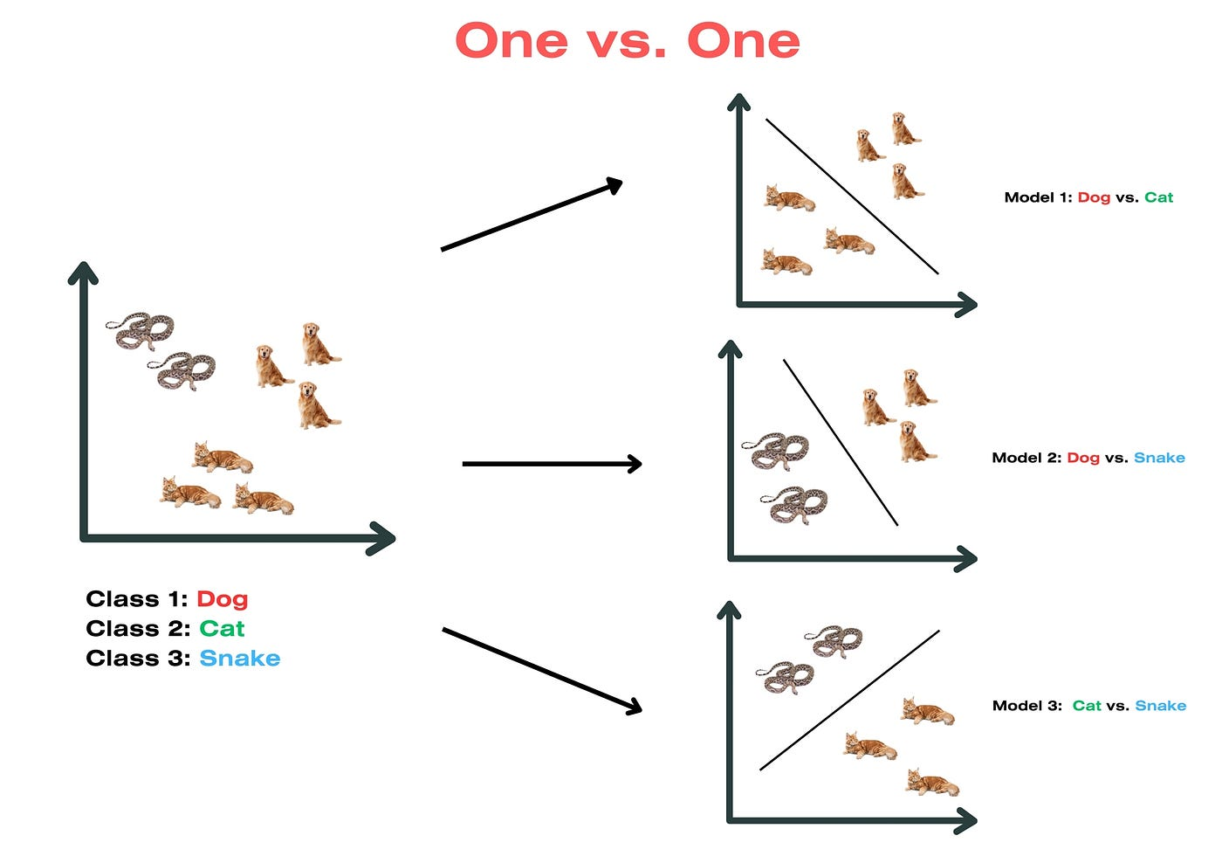
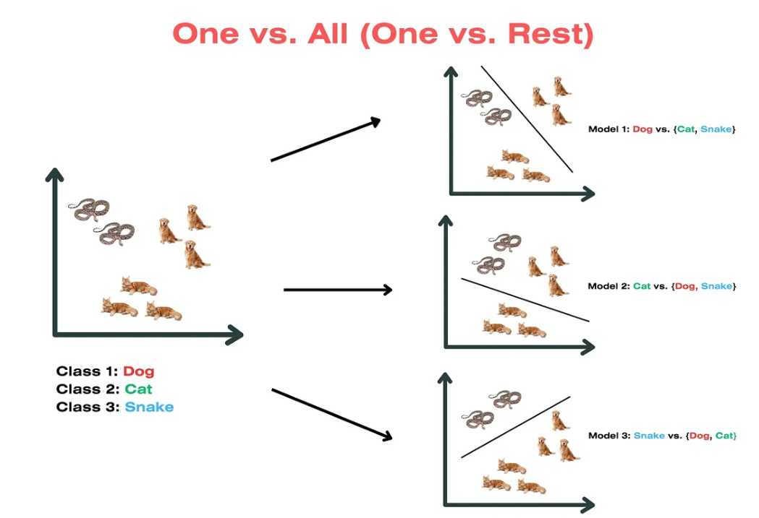
Multi-Class Classification

Slide 5
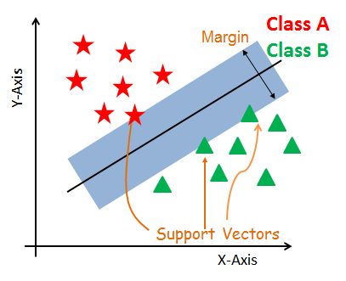
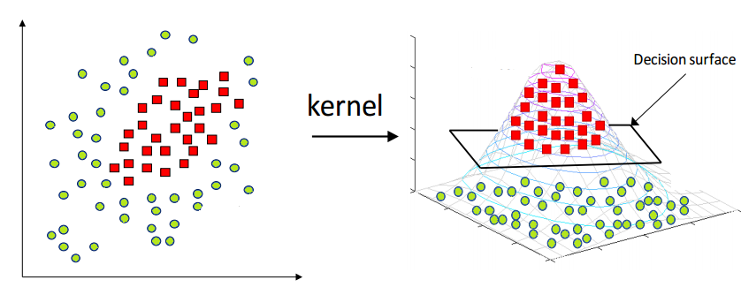
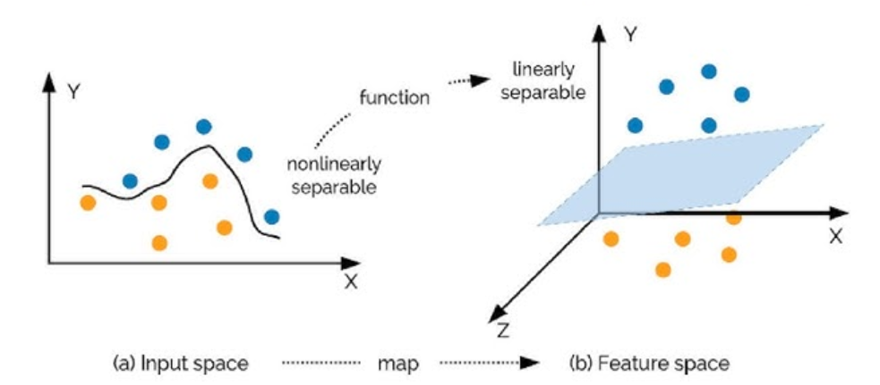
Recap on SVM Models

Slide 6
Recap on SVM Algorithm
Input Data
Define the Hyperplane
Training and Prediction
Collect and preprocess the data, ensuring features are properly scaled and relevant for the classification task.
SVM identifies the optimal hyperplane by maximizing the margin between classes.
Support vectors (the closest data points) help determine the position and orientation of this hyperplane.
SVM learns from the training data, adjusting parameters to minimize errors while keeping the widest margin possible.
With the trained model, SVM can classify new, unseen data points based on which side of the hyperplane they fall on.

Slide 7
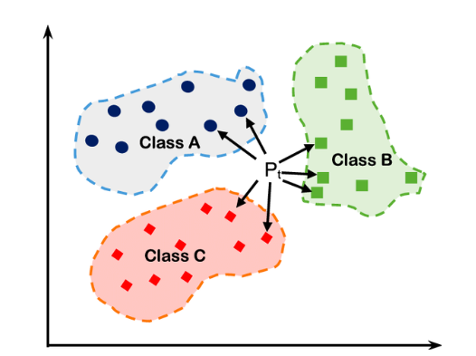
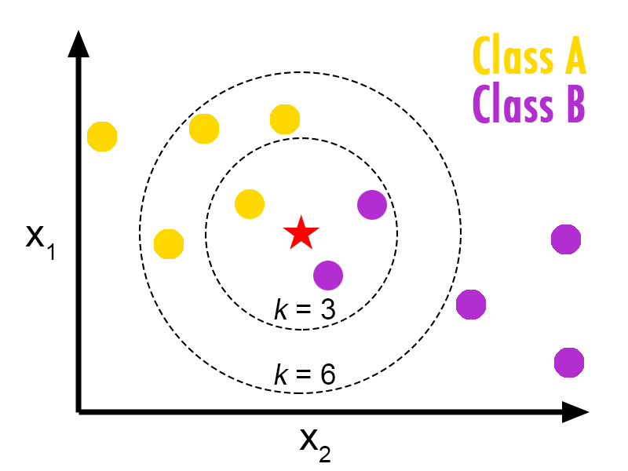
Recap on KNN Models

Slide 8
Recap on KNN Algorithm
Grid Search
Use a grid search algorithm to systematically test a range of K values and find the optimal one.
o
Cross-Validation
Test different K values on subsets of your data to see which provides the best accuracy and generalization on unseen data.
o
Odd vs Even K
For binary classification, an odd K value helps avoid ties when neighbors vote on the class.
o
Start with sqrt(n)
A common rule of thumb is to start with K equal to the square root of the number of data points (n).
o

Slide 9
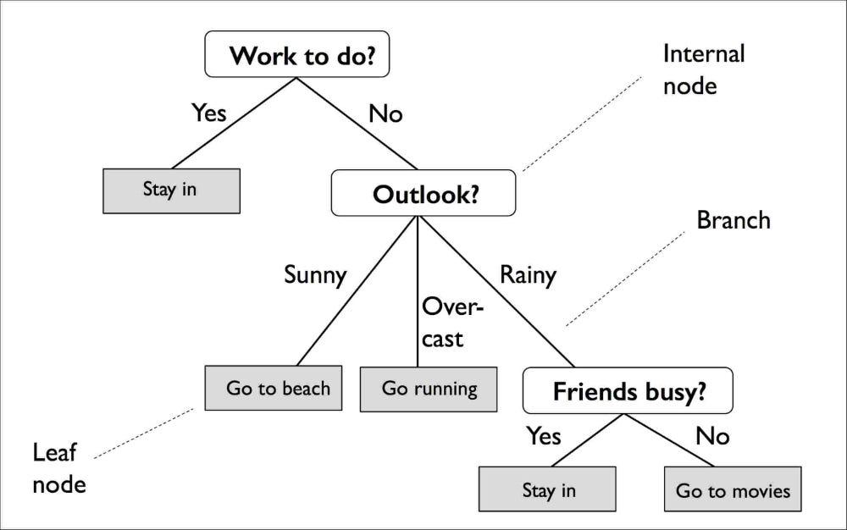
Recap on Decision Tree Models
A decision tree has a few key parts:
Nodes: These are decision points where the data gets split based on a certain feature.
Edges: These are the paths that connect one decision point to another, showing the result of each split.
Root: This is the very first decision point in the tree where the initial split happens.
Leaves: These are the endpoints of the tree, where the final decisions or predictions are made.

Slide 10
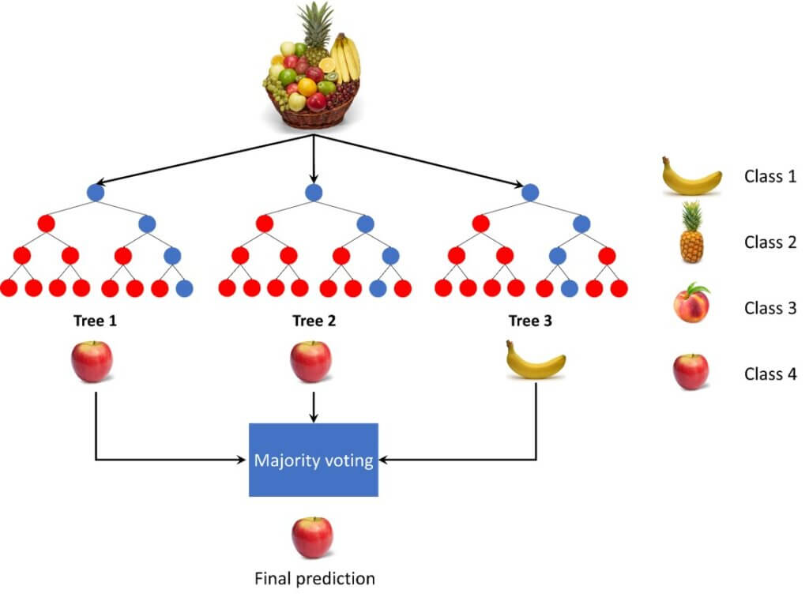
Recap on Random Forest Algorithms
A decision forest classifies fruits by creating multiple decision trees, each trained on random samples of the data and focusing on different fruit features (like color, texture, and size). Each tree makes its own prediction, classifying a fruit as, say, an apple, banana, or orange. The algorithm then combines these individual predictions through a voting process: the most common classification among all trees becomes the final result. This method improves accuracy by averaging out errors from individual trees, leading to a more reliable classification.

Slide 11
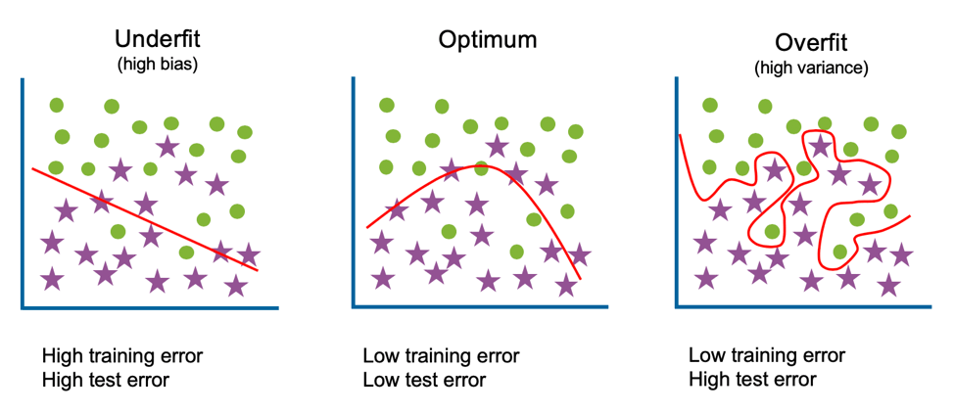
Overfitting and Underfitting

Slide 12
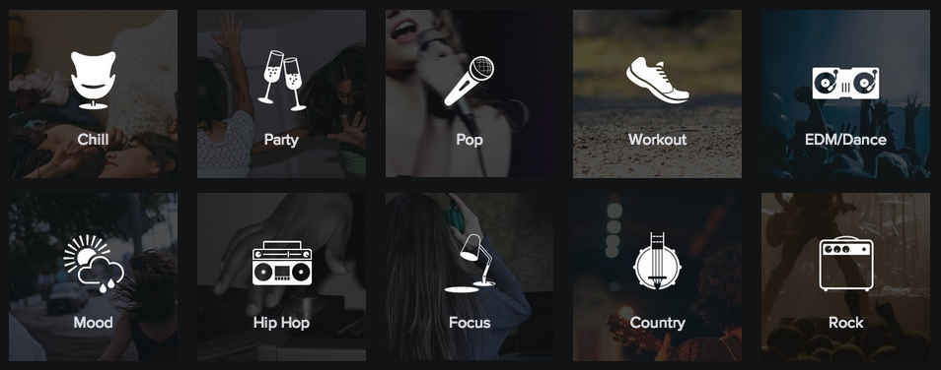
Classification Project

Slide 13
Step 1 - Download Dataset from Kaggle
Right click archive.zip. Select Extract Here…,. Windows will create a folder with the extracted files in the current location.
Create a Kaggle Account
Navigate to the Dataset Page
On the dataset page, click the Download button. Kaggle will download a .zip file named archive.zip.
Unzip the File - Mac
Download the Dataset
Unzip the File - Windows
Go to the Kaggle website and sign up for an account if you don’t already have one.
Open the dataset link in your browser: Spotify Tracks Dataset. Log into your Kaggle Account
Go to the Downloads folder and locate the .zip file (e.g., archive.zip).Simply double-click on the file to unzip it.
1
2
3
4A
4B

Slide 14
Step 2 - Set Up Google Colab
To begin working with the dataset, open the provided Google Colab link: Google Colab Notebook.
Once the notebook opens, locate the dataset.csv file on your computer. This file might be in your Downloads folder or in a folder named archive, depending on where you saved or extracted it. In the Colab notebook, look for the Files sidebar on the left. If the sidebar isn’t visible, click on the folder icon to expand it. Then, drag and drop the dataset.csv file into the Files section. This action uploads the file directly to your Colab environment, making it accessible for use in the notebook.

Slide 15
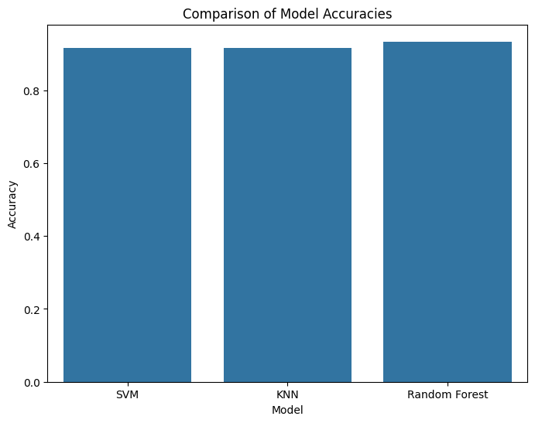
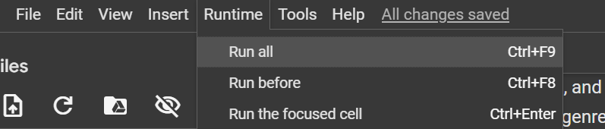
Step 3 - Run the Notebook
Run all cells in the notebook and save the outputted Comparison of Model Accuracies chart as a screenshot. Every time you run the notebook, make sure you take a screenshot and save the new outputted chart, you will need these screenshots for the final step.

Slide 16
Step 4 - Experiment with the Genres
Select Genres
For this project, you’ll conduct three classification experiments. One experiment should be binary (classifying between two genres), while the other two will be multiclass (classifying among multiple genres).
Choose Your Genres Below are some genre options available in the dataset:
['rock', 'rap', 'jazz', 'latin', 'country', 'pop', 'classical', 'electronic', 'acoustic', 'r-and-b']
Feel free to explore the dataset if you'd like to use other genres, this dataset has over 100 genres available!
Instructions
Binary Experiment: Choose two genres that you want to classify between (e.g., Rock vs. Jazz). This experiment will help you understand classification when only two classes are present.
Multiclass Experiments: For the other two experiments, choose three or more genres to create multiclass classification problems (e.g., Rock, Pop, and Classical). These experiments will show how classification models perform with more categories.

Slide 17
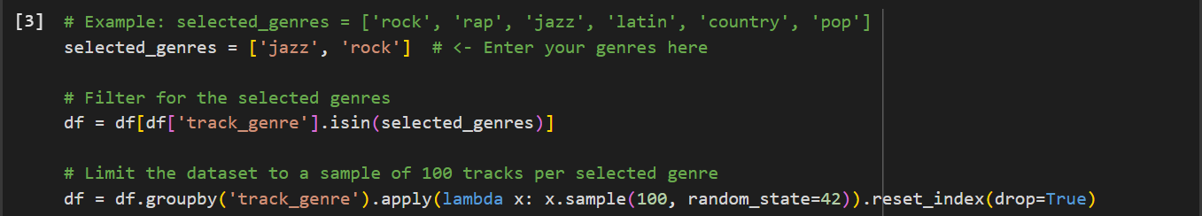
Step 4 - Experiment with the Genres

Slide 18
Step 5 - Experiment with the Features
Feature Selection Experiments
Experiment 1: Train with all features Train your models (SVM, KNN, and Random Forest) using all features to establish a baseline. You can do this by running the rest of the notebook without making any changes.
Experiment 2: Remove one highly correlated feature Identify a pair of features with a correlation around |0.7| or higher, then remove one and re-train your models. Note any differences compared to the baseline.
Experiment 3: Remove multiple correlated features Remove multiple features with correlations around |0.7| or higher. Re-train your models and compare these results with both the baseline and Experiment 2.
These experiments will help you understand the impact of correlated features on model performance.

Slide 19
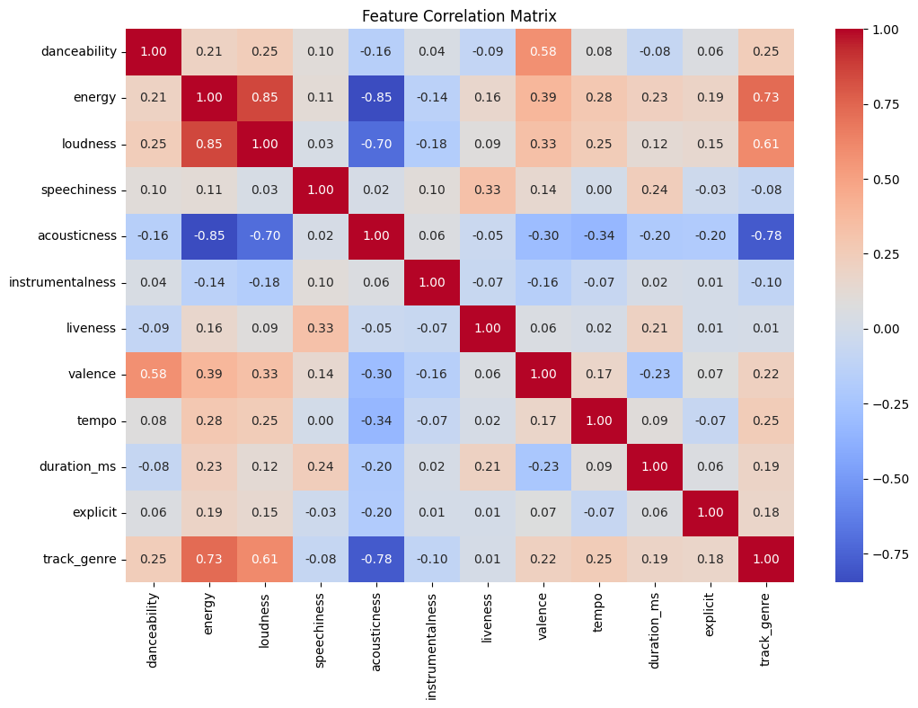
Step 5 - Experiment with the Features
Hints:
Ignore all values with 1.00 correlation! They are tautologies, energy being correlated with energy is not meaningful.
Attributes with high correlations (negative or positive) with track_genre, our dependent variable should not be removed as they very useful for predicting the genre.

Slide 20
Step 6 - Compare the Models
Using the screenshots you’ve taken of the Comparison of Model Accuracies chart during these different experiments, write a summary of these results and how they varied based on the experiments. In your summary, make sure you include which model performed the best and support this claim with evidence.

Slide 21
Classification
Congratulations on completing the music genre classification project! You've explored how to use machine learning models for classification, tested the effects of correlated features, and compared model performances. But there’s always more to try! For example, you could experiment with tuning model hyperparameters (like adjusting n_neighbors in KNN or n_estimators in Random Forest) to see if you can improve accuracy. Another interesting approach is to try using One-vs-Rest (OVR) or One-vs-One (OVO) classification methods—these techniques allow you to handle multiclass classification in different ways, which may affect the performance of models like SVM. Keep experimenting, and see how each approach provides new insights into your analysis!

